Slide 1

Network Traffic Classification Using Machine Learning and Deep Learning Approaches
Liu, Yucheng

Slide 2

Research Background

Slide 3
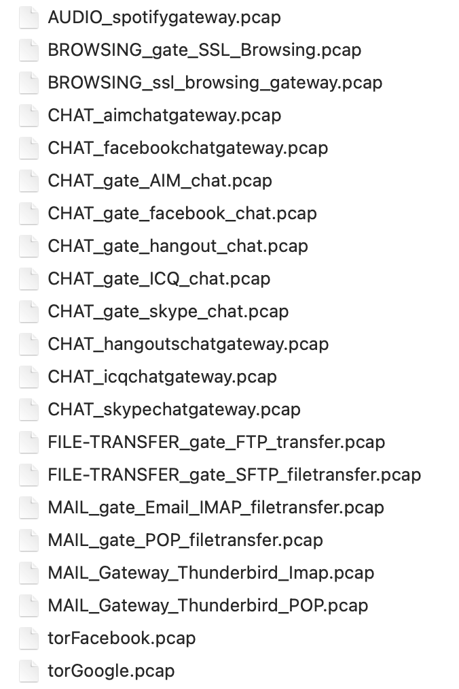
Project Objectives
Flow classification goal: map raw encrypted traffic → application labels (e.g. Chat vs. Video vs. P2P)
End‐to‐end pipeline: PCAP ⟶ feature extraction ⟶ ML/DL model ⟶ real‐time inference
Key questions:
Can lightweight ML (K-NN, RF) match deep models?
Does temporal modeling (CNN+RNN) improve accuracy?
What is the training time vs. accuracy trade-off?

Slide 4
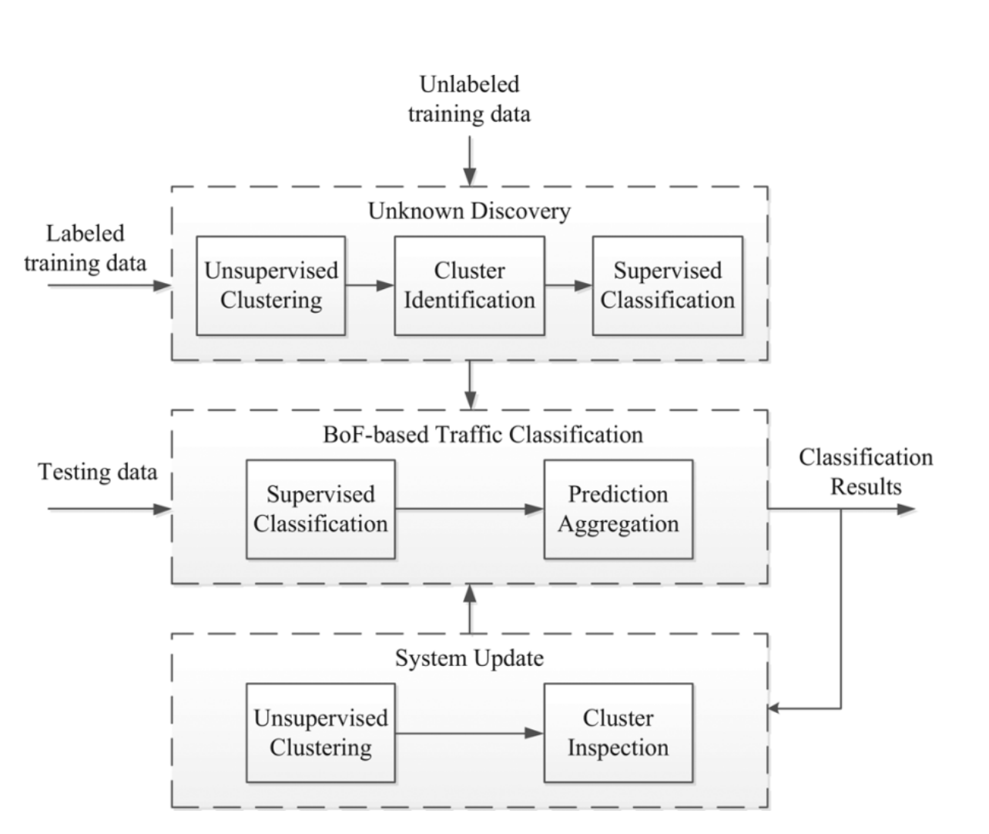
Project Objectives
Flow classification goal: map raw encrypted traffic → application labels (e.g. Chat vs. Video vs. P2P)
End‐to‐end pipeline: PCAP ⟶ feature extraction ⟶ ML/DL model ⟶ real‐time inference
Key questions:
Can lightweight ML (K-NN, RF) match deep models?
Does temporal modeling (CNN+RNN) improve accuracy?
What is the training time vs. accuracy trade-off?

Slide 5
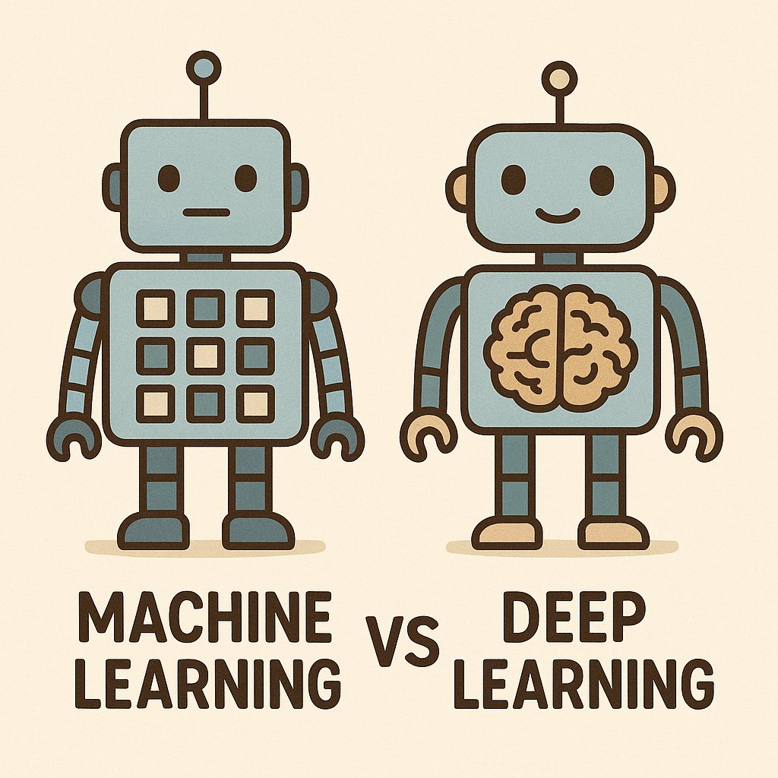
Project Objectives
Flow classification goal: map raw encrypted traffic → application labels (e.g. Chat vs. Video vs. P2P)
End‐to‐end pipeline: PCAP ⟶ feature extraction ⟶ ML/DL model ⟶ real‐time inference
Key questions:
Can lightweight ML (K-NN, RF) match deep models?
Does temporal modeling (CNN+RNN) improve accuracy?
What is the training time vs. accuracy trade-off?

Slide 6
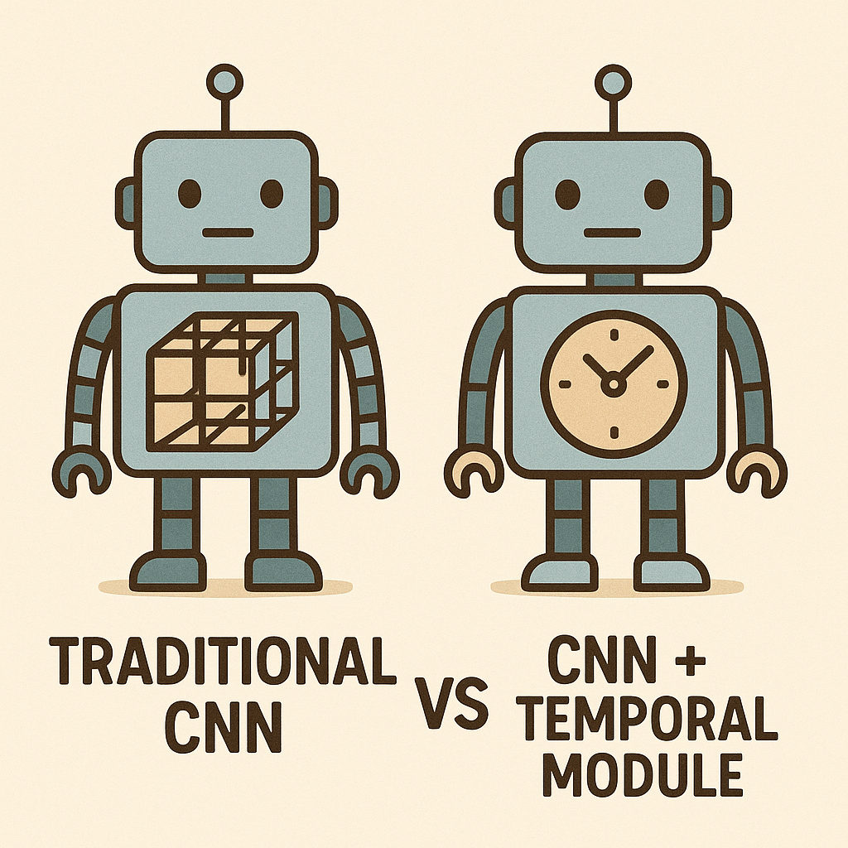
Project Objectives
Flow classification goal: map raw encrypted traffic → application labels (e.g. Chat vs. Video vs. P2P)
End‐to‐end pipeline: PCAP ⟶ feature extraction ⟶ ML/DL model ⟶ real‐time inference
Key questions:
Can lightweight ML (K-NN, RF) match deep models?
Does temporal modeling (CNN+RNN) improve accuracy?
What is the training time vs. accuracy trade-off?

Slide 7
Key Challenges
Raw PCAP complexity: packet parsing, flow reassembly, noise removal
Feature selection: hundreds of statistical metrics; choosing meaningful subset
Capturing temporal patterns:per-flow aggregates lose intra-flow dynamics / need sub-window sequence representation

Slide 8
Key Challenges
Raw PCAP complexity: packet parsing, flow reassembly, noise removal
Feature selection: hundreds of statistical metrics; choosing meaningful subset
Capturing temporal patterns:per-flow aggregates lose intra-flow dynamics / need sub-window sequence representation

Slide 9
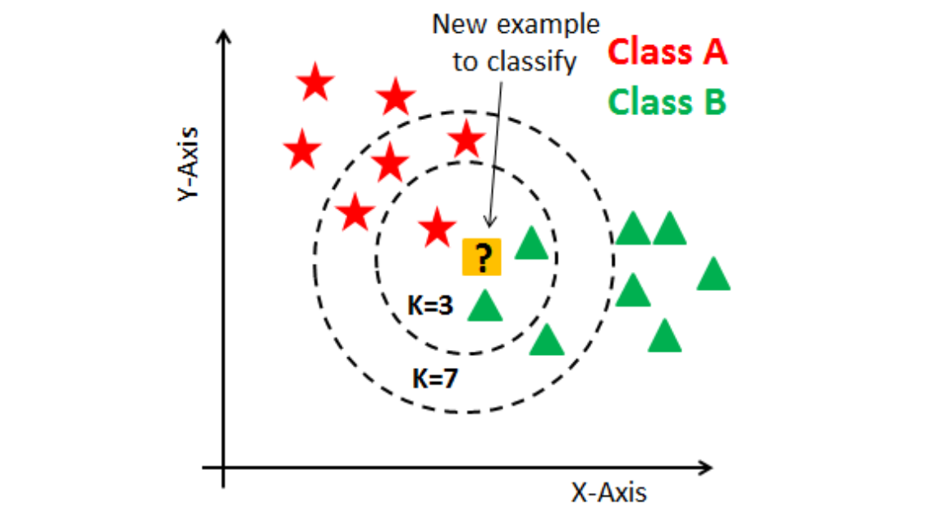
Review – Traditional ML
K-Nearest Neighbors (K-NN)
simple, non-parametric; labels by nearest feature vectors
Pros: no training phase, interpretable
Cons: slow at inference, sensitive to feature scaling

Slide 10
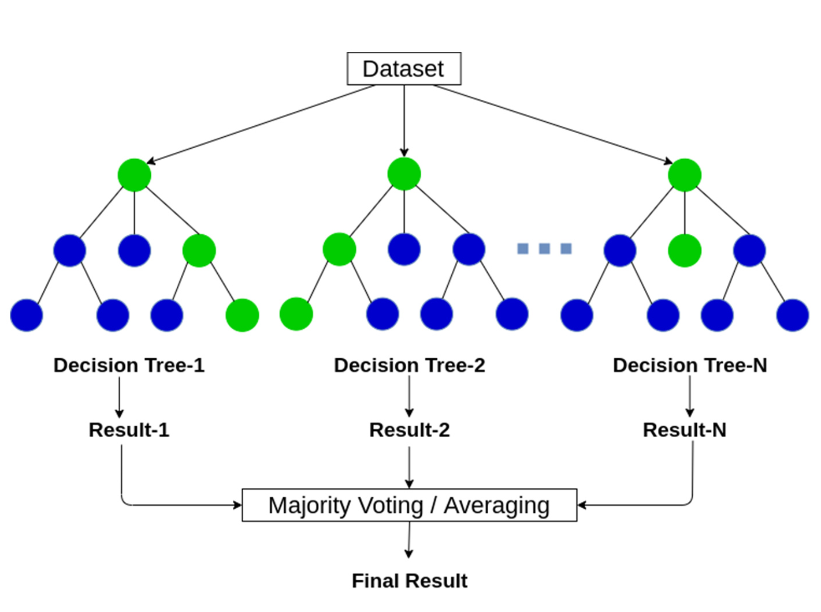
Review – Traditional ML
Random Forest (RF)
Ensemble of decision trees trained on random subsets of samples & features
Pros:Robust to noise and overfitting, Handles high-dimensional data well
Cons:Large model size, Longer training time as number of trees grows

Slide 11
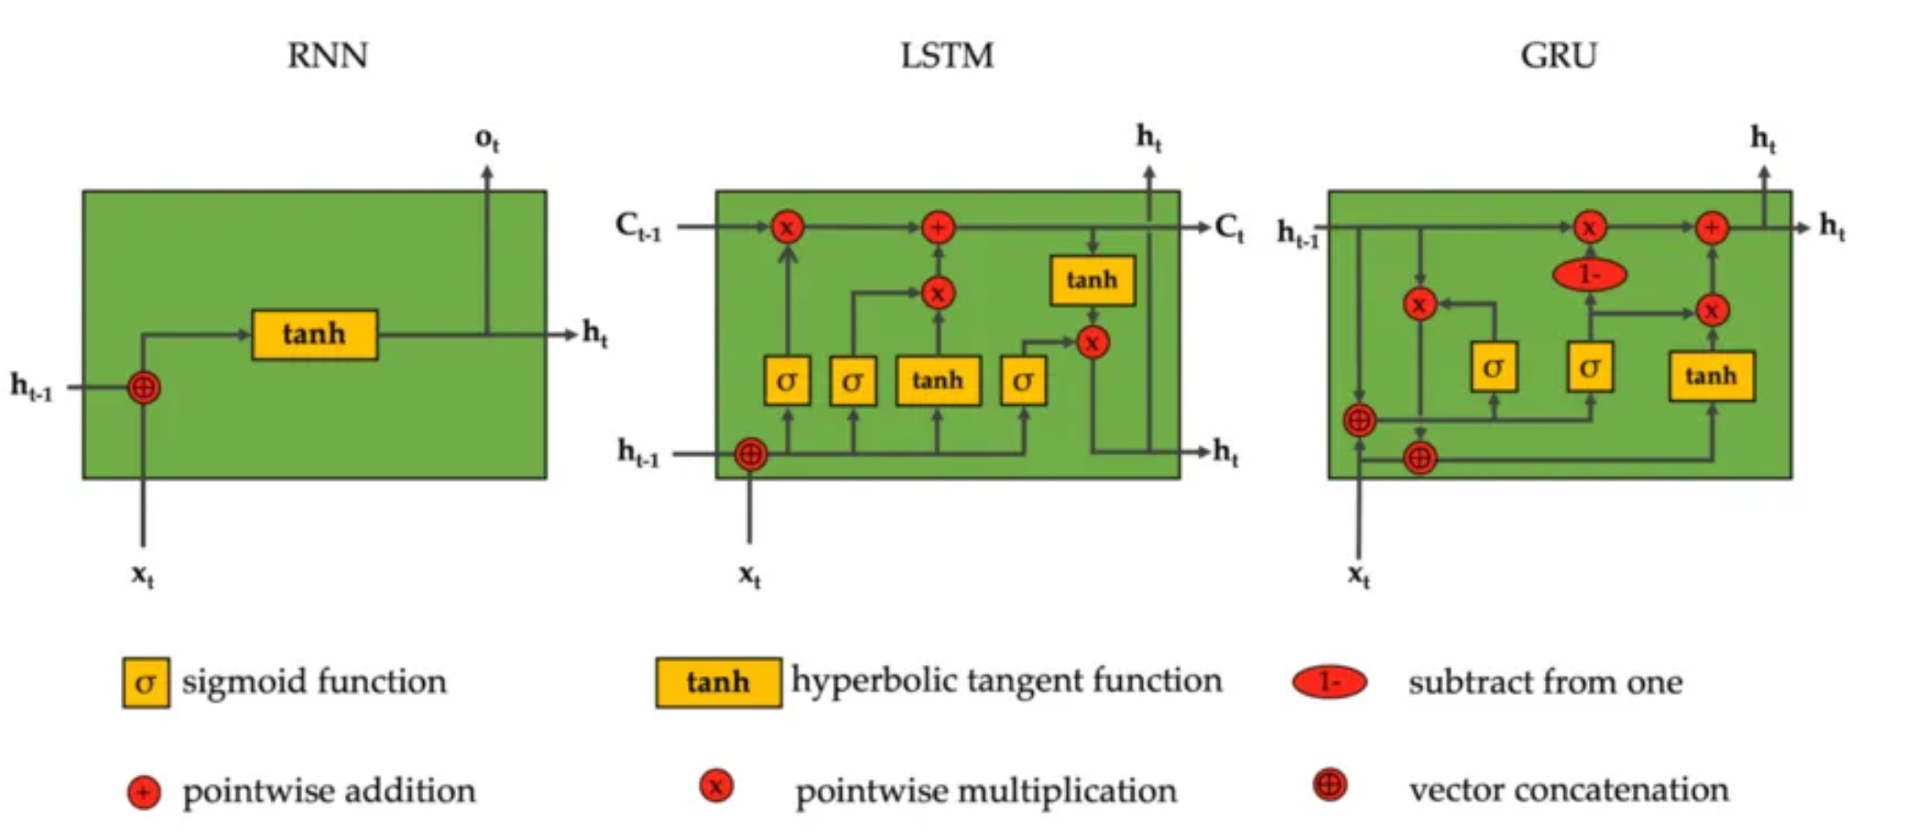
Review – Deep Learning Method
RNN family (LSTM / GRU)
model long/short-term temporal dependencies across windows
handle variable-length flows, resistant to jitter

Slide 12
Review – Deep Learning Method
Hybrid architectures
CNN + LSTM/GRU pipeline (Zeng et al., IEEE Access 2019 “Deep-Full-Range”)
integrate spatial & temporal modules for best of both worlds

Slide 13
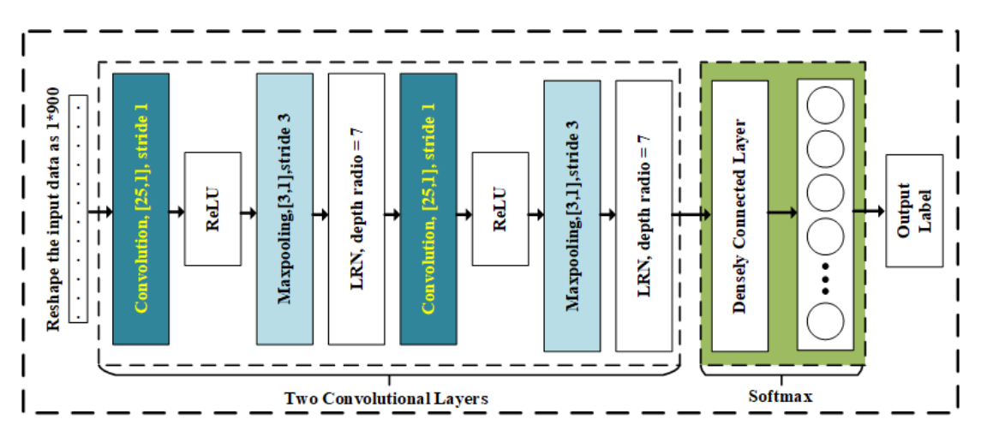
Review – Deep Learning Method

Slide 14
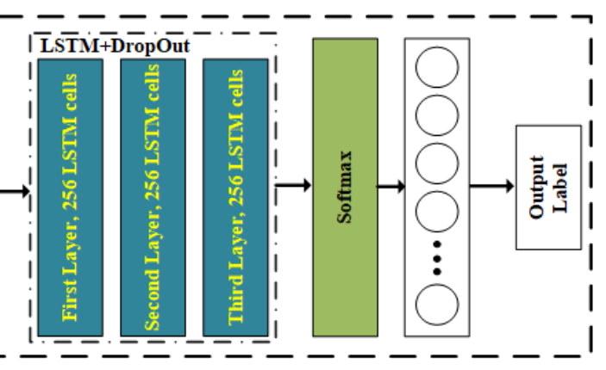
Review – Deep Learning Method

Slide 15
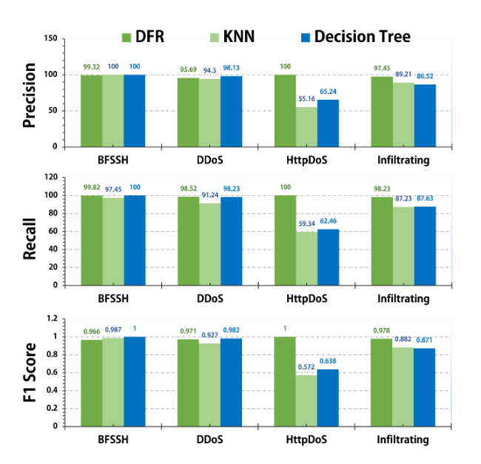
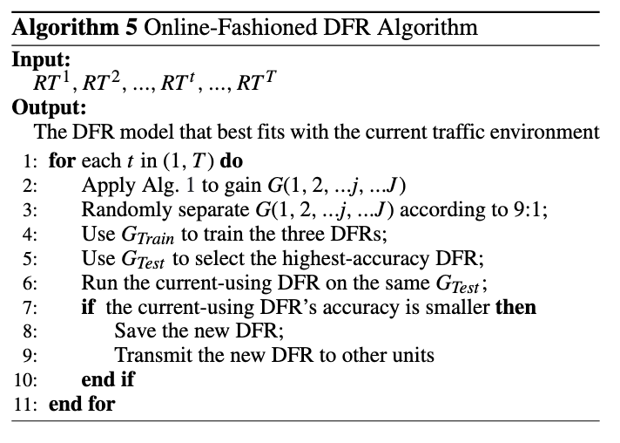
Review – Deep Learning Method
Deep-Full-Range: A Deep Learning Based Network Encrypted Traffic Classification and Intrusion Detection Framework
Yi Zeng; Huaxi Gu

Slide 16
Preparation
./pcap_analysis.py

Slide 17

Data Processing & Feature Extraction
PCAP File Collection
Collect network traffic data in PCAP format
Extract traffic labels from filenames

Slide 18
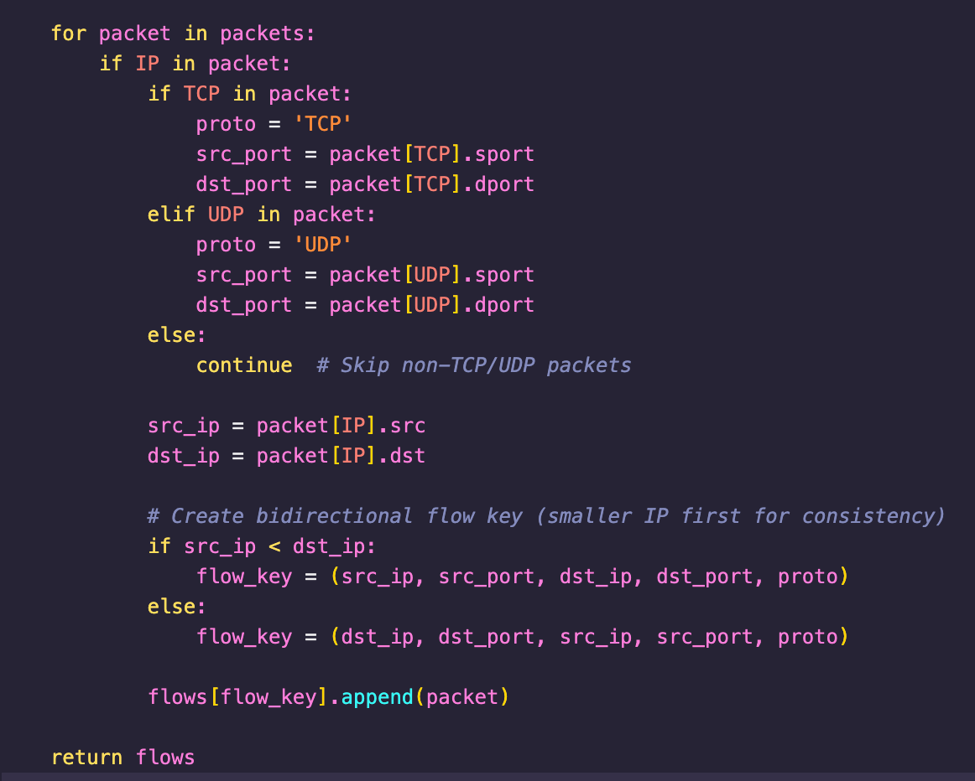
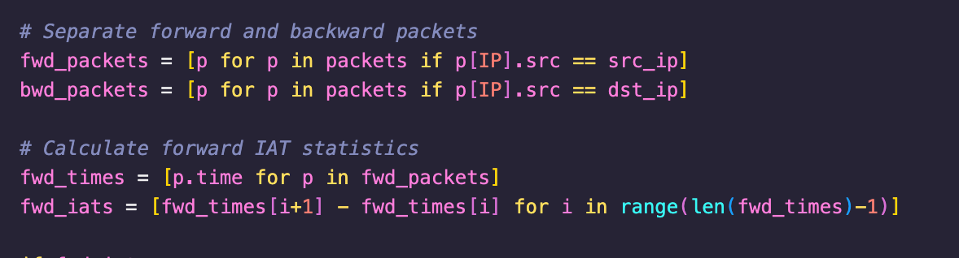
Data Processing
Group packets by 5-tuple: (src_ip, src_port, dst_ip, dst_port, protocol)
Split flows into 10-second subflows for consistent analysis
Separate forward and backward traffic directions

Slide 19
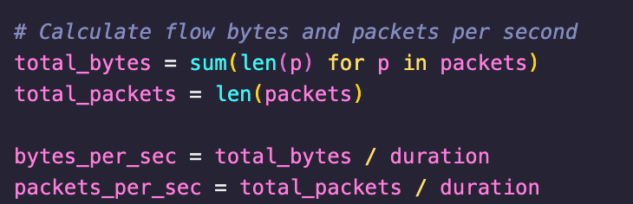
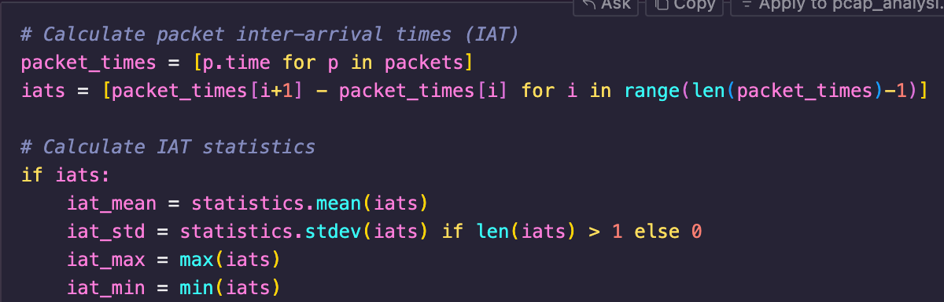
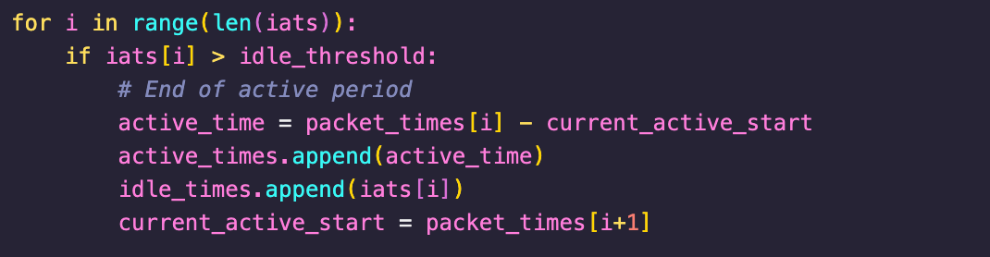
Feature Extraction – Basic Features
Flow Duration, Flow Bytes/s, Flow Packets/s
IAT Statistics (Mean, Std, Max, Min) for:
Overall Flow
Forward Direction
Backward Direction
Active/Idle Time Statistics

Slide 20
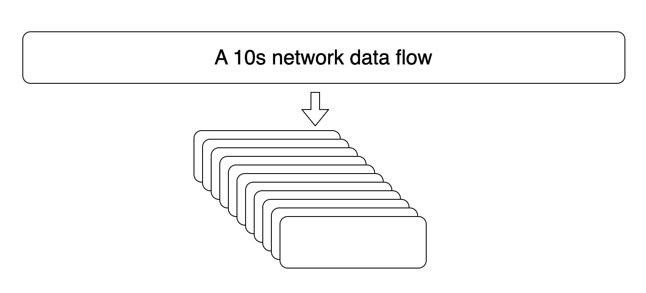
Feature Extraction - Temporal Features
Advanced Temporal Features (80 features)
10 time windows × 8 features per window:
Packets_Count, Bytes_Count
IAT_Mean, IAT_Std
Fwd_IAT_Mean, Fwd_IAT_Std
Bwd_IAT_Mean, Bwd_IAT_Std

Slide 21
Data Processing
Preprocessing Steps:
Remove IP addresses and ports
Handle missing values
Replace infinite values
Standardize features (zero mean, unit variance)
Split data (80% training, 20% testing)

Slide 22
My Model Architecture
./base_model.py
./advanced_model.py

Slide 23
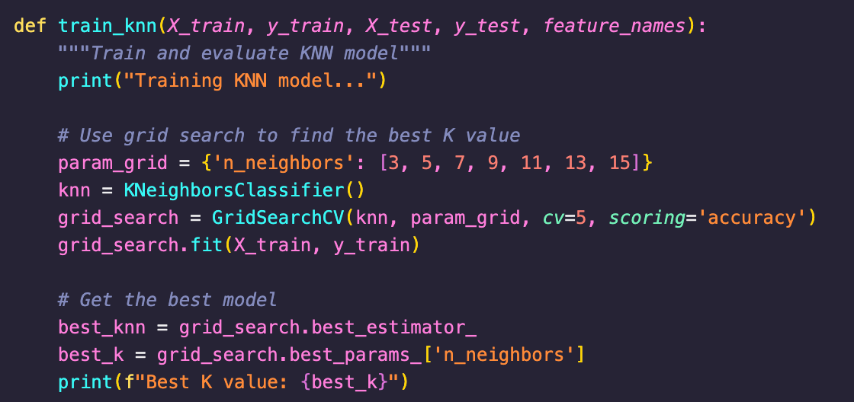
KNN
Hyperparameter Optimization: GridSearchCV with 5-fold cross-validation
K values tested: 3, 5, 7, 9, 11, 13, 15
Distance Metric: Euclidean (default)
Weight Function: Uniform weighting (default)

Slide 24
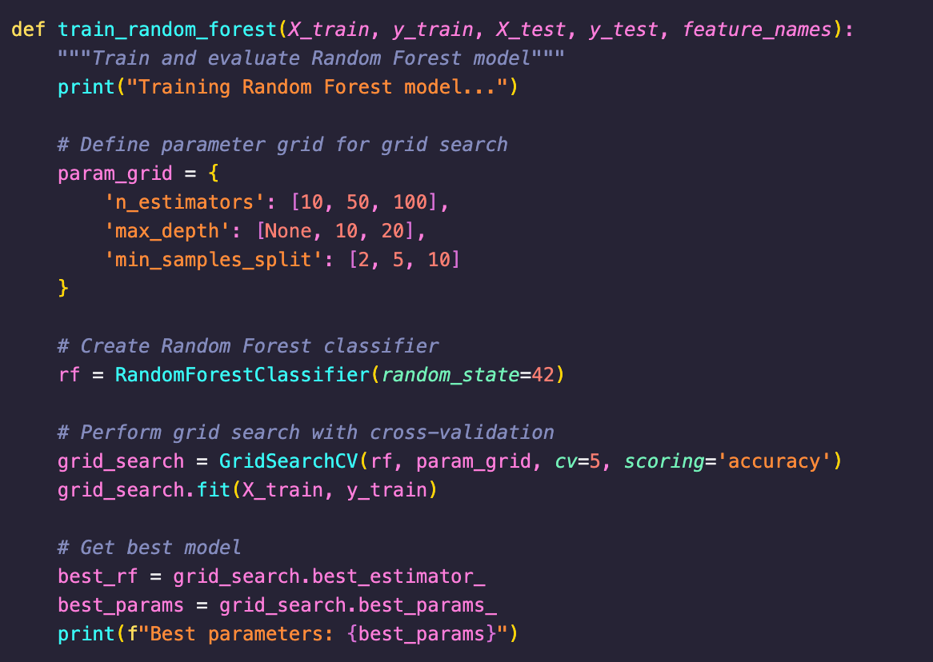
Random Forest
Trees in Forest: 10, 50, or 100 (optimized via GridSearchCV)
Max Tree Depth: None , 10, or 20
Min Samples to Split: 2, 5, or 10
Criterion: Gini impurity (default)
Bootstrap: True (default)

Slide 25
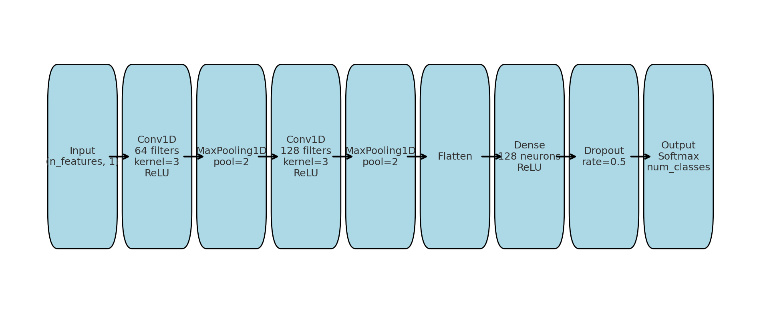
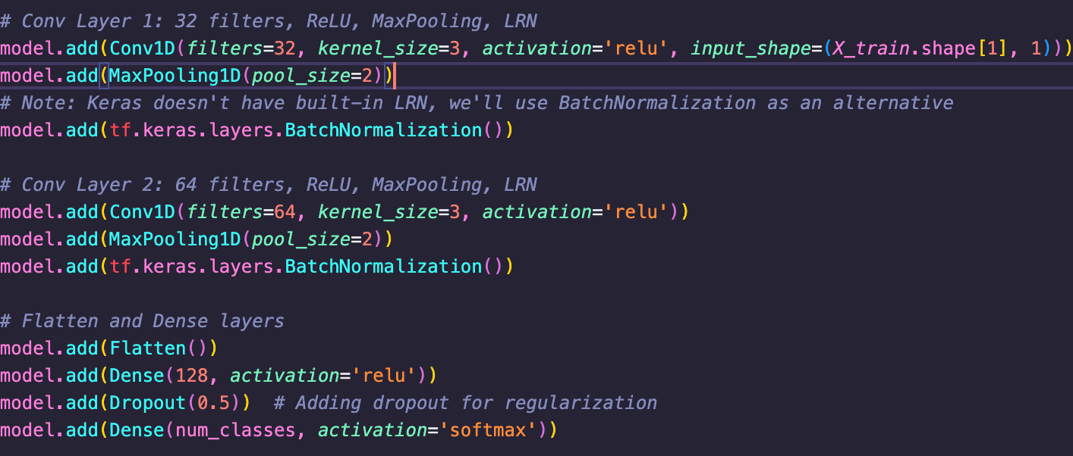
1D-CNN

Slide 26
CNN + LSTM
CNN Layers:
Conv1D: 64 filters, kernel size 3, ReLU activation, same padding
MaxPooling1D: pool size 2
Conv1D: 128 filters, kernel size 3, ReLU activation, same padding
MaxPooling1D: pool size 2
RNN Layers:
Bidirectional LSTM: 128 units, return sequences=True
Dropout: 30%
LSTM: 64 units
Dropout: 30%

Slide 27
CNN + GRU (simplified version LSTM)
CNN Layers:
Conv1D: 64 filters, kernel size 3, ReLU activation, same padding
MaxPooling1D: pool size 2
Conv1D: 128 filters, kernel size 3, ReLU activation, same padding
MaxPooling1D: pool size 2
RNN Layers:
Bidirectional LSTM: 128 units, return sequences=True
Dropout: 30%
GRU: 64 units
Dropout: 30%

Slide 28
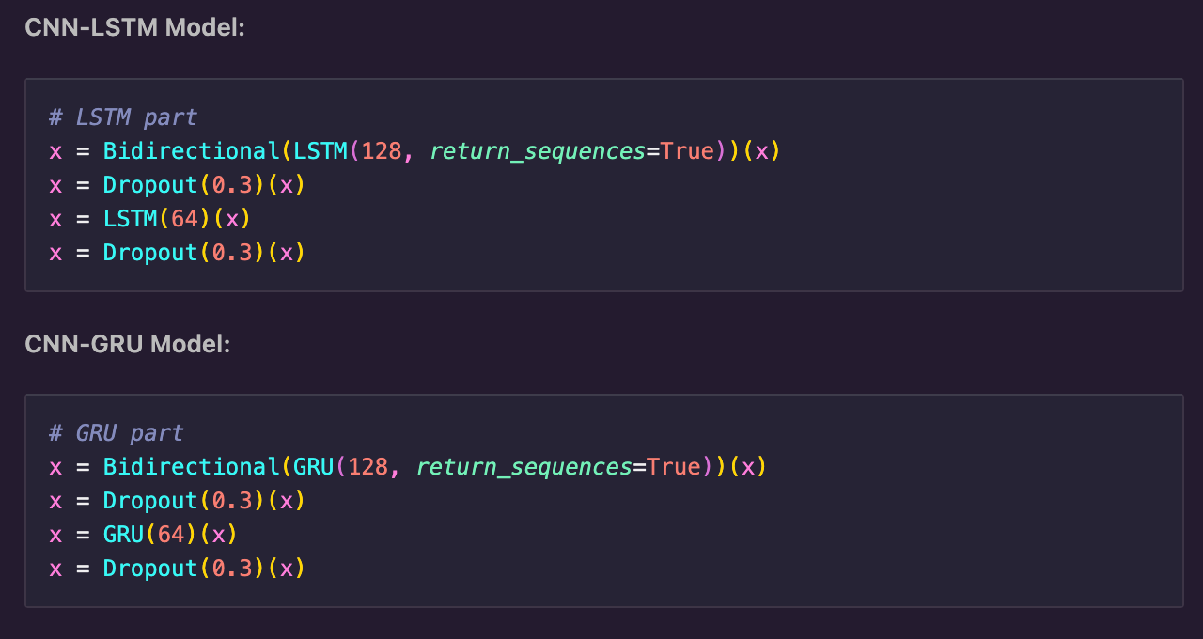
LSTM vs GRU
Internal Architecture
LSTM: Has 3 gates (input, forget, output)
GRU: Has 2 gates (update, reset)
Parameter Count
LSTM: 4 weight matrices (more parameters)
GRU: 3 weight matrices (fewer parameters)

Slide 29
Result Analysis

Slide 30
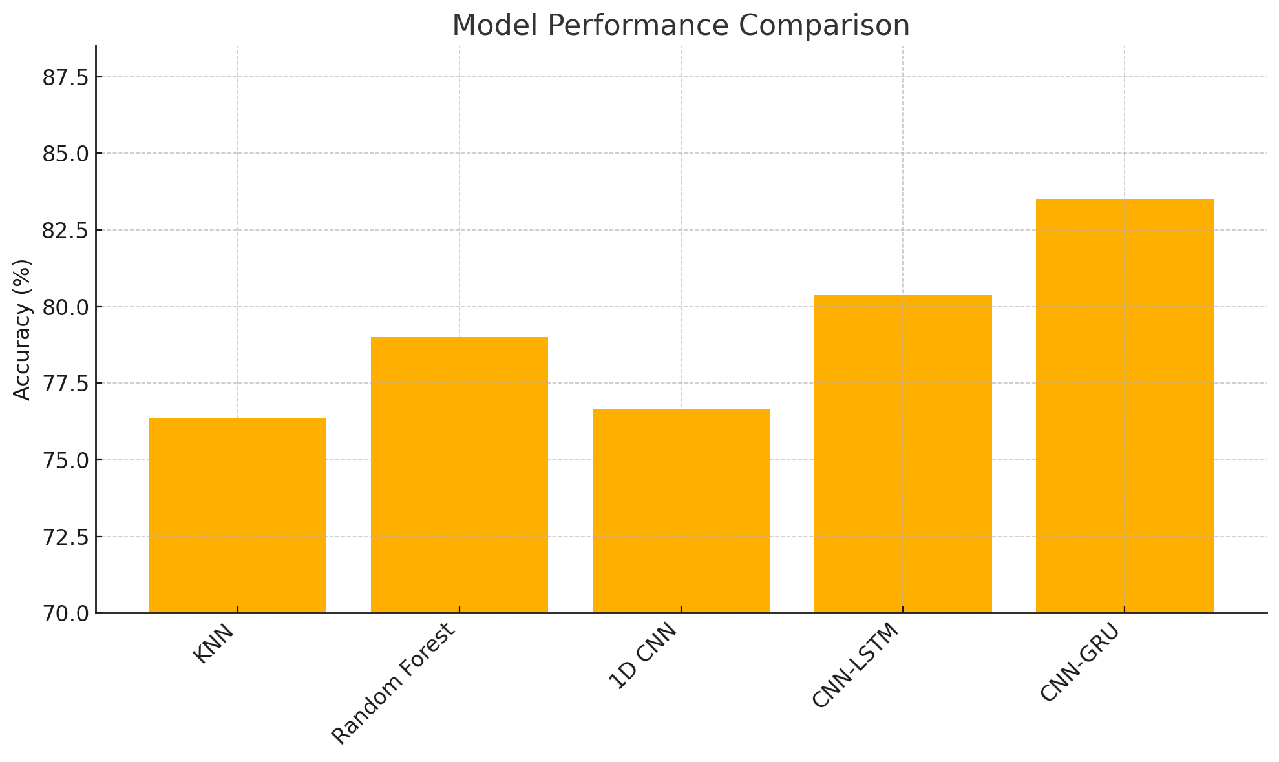
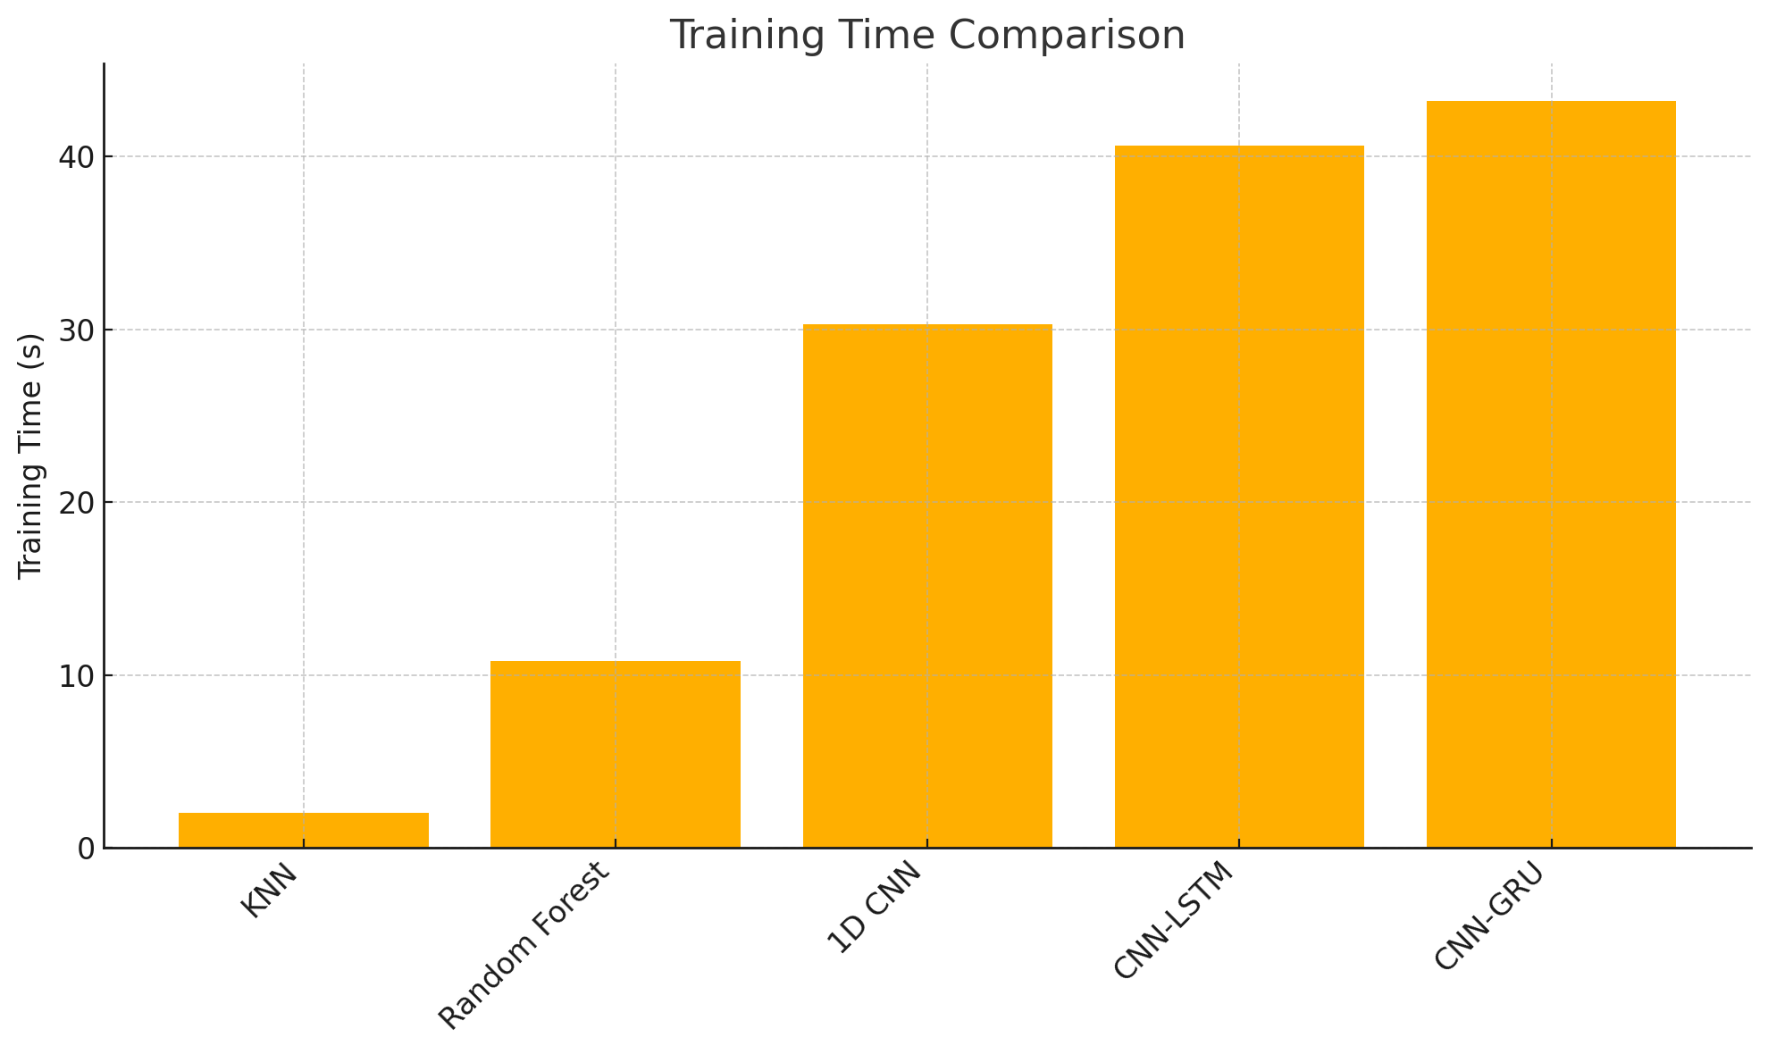
Accuracy
Time Spent

Slide 31
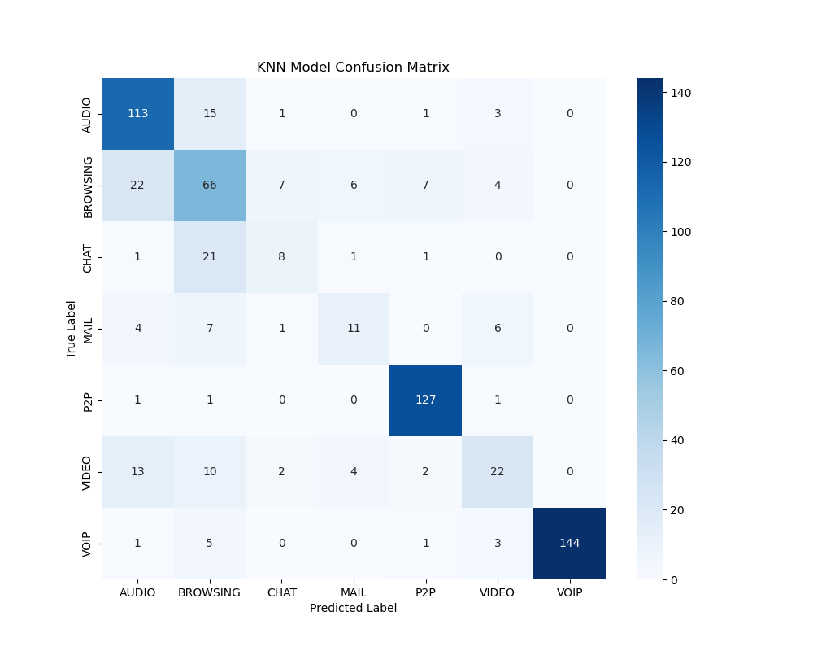
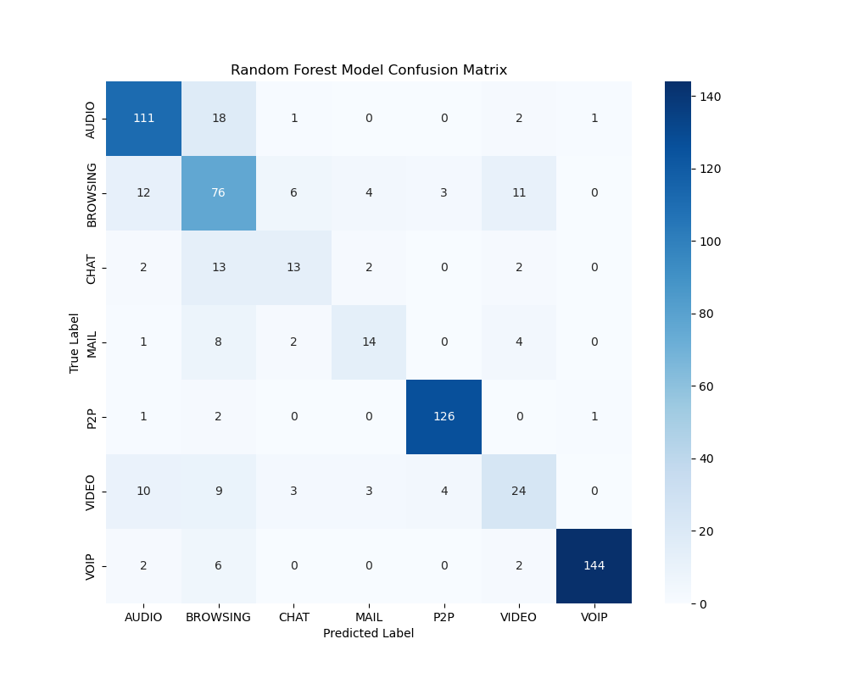
KNN
RF

Slide 32
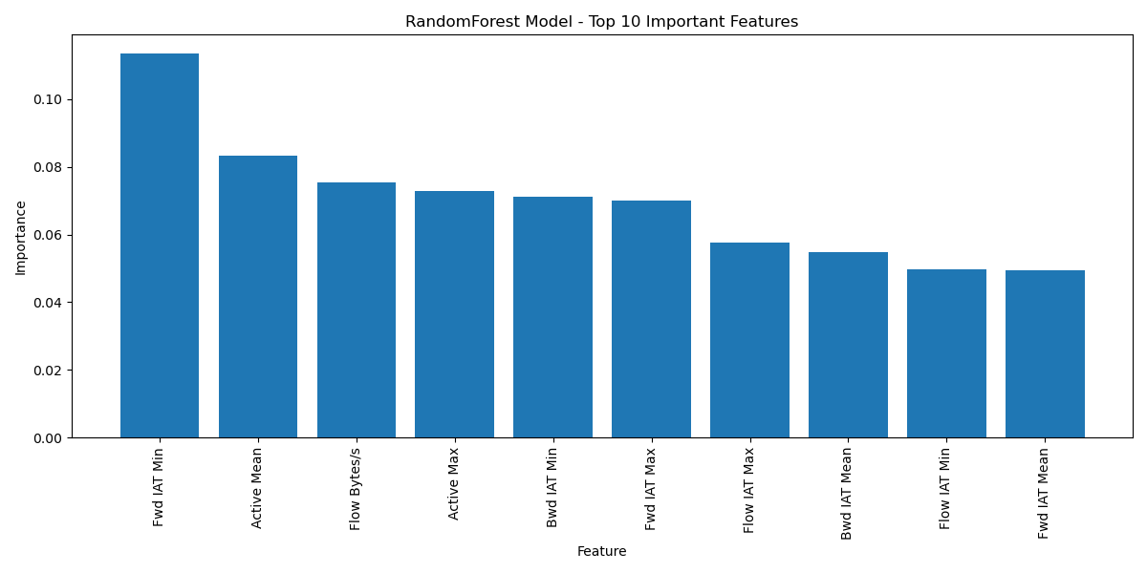
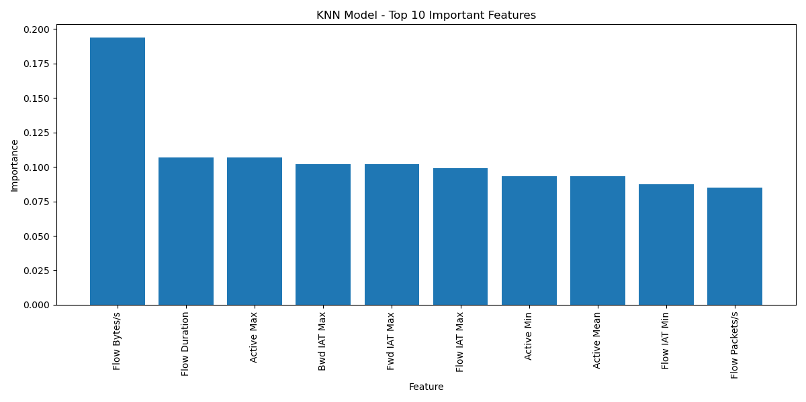
KNN
RandomForest

Slide 33
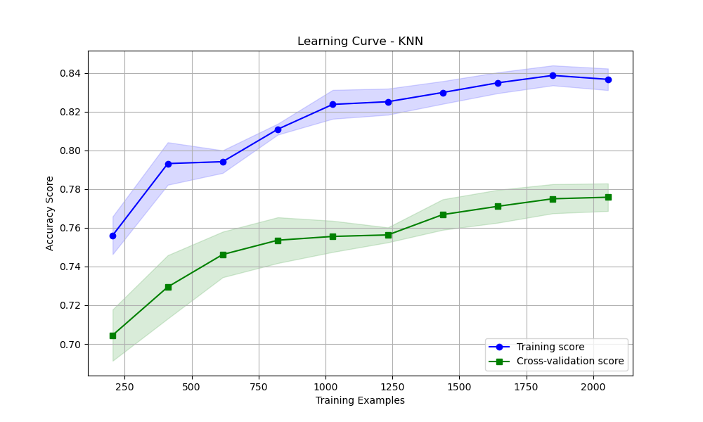
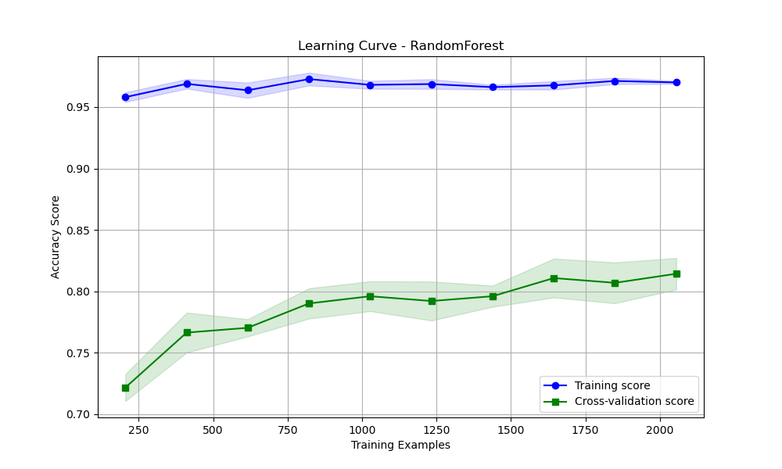
Learning_Curve - KNN
Learning_Curve - RF

Slide 34
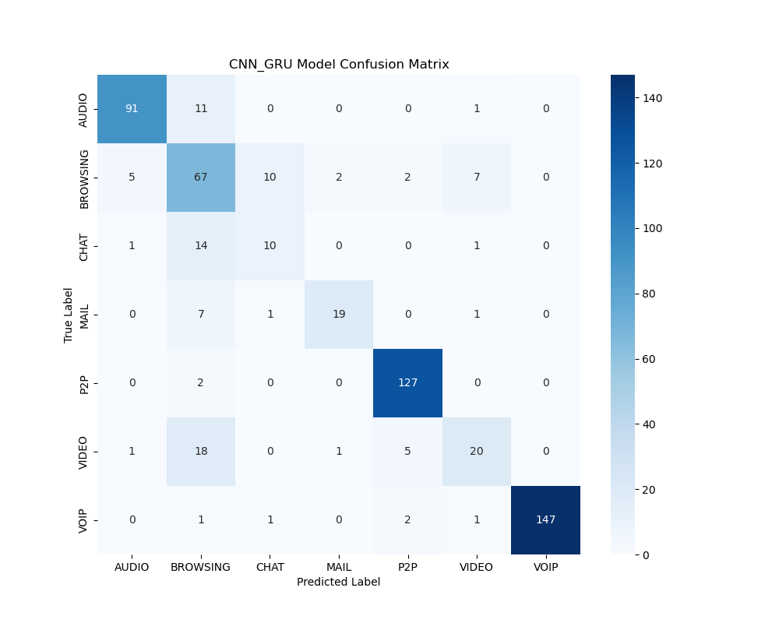
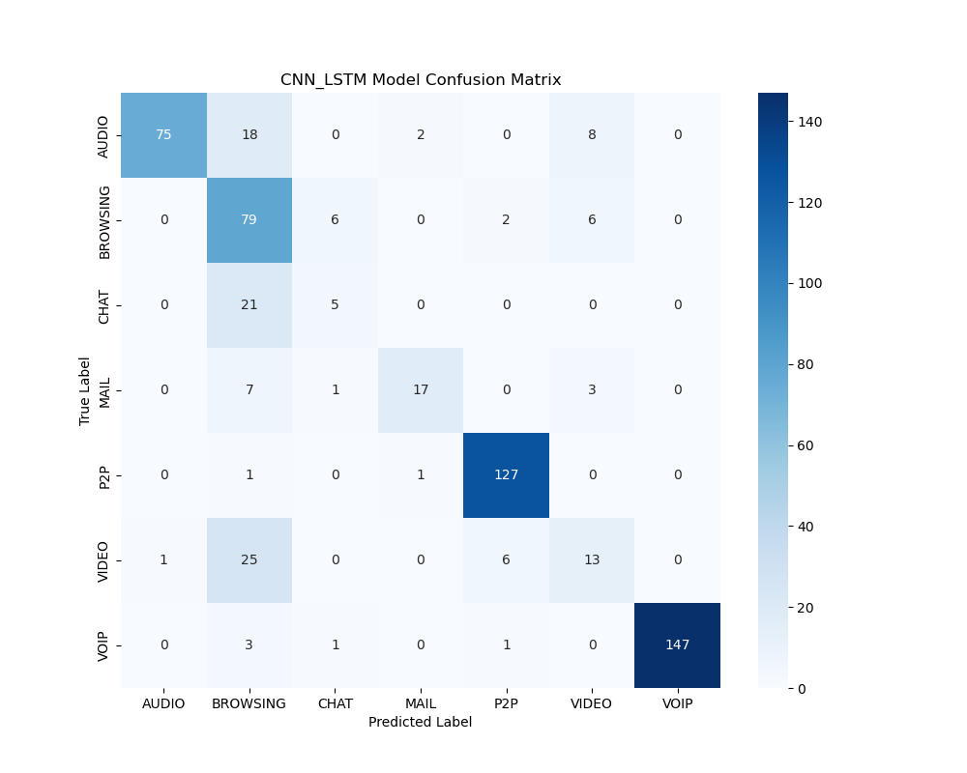
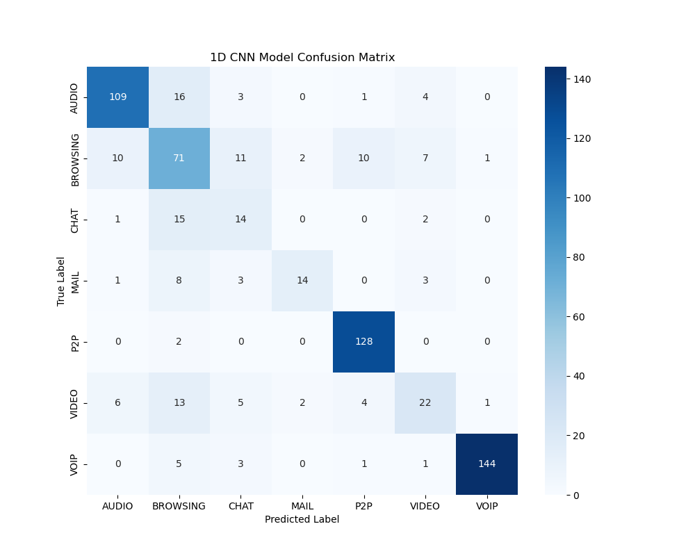
CNN_GRU
CNN_LSTM
1D_CNN

Slide 35
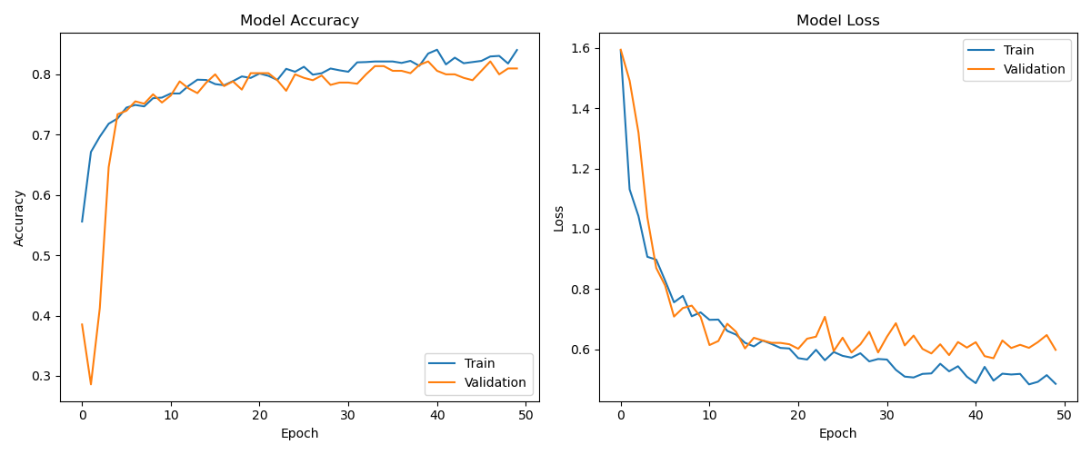
1D_CNN

Slide 36
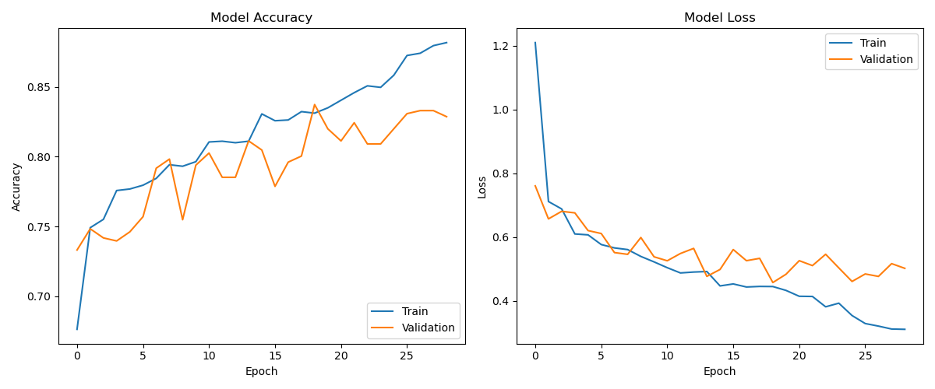
CNN_LSTM

Slide 37
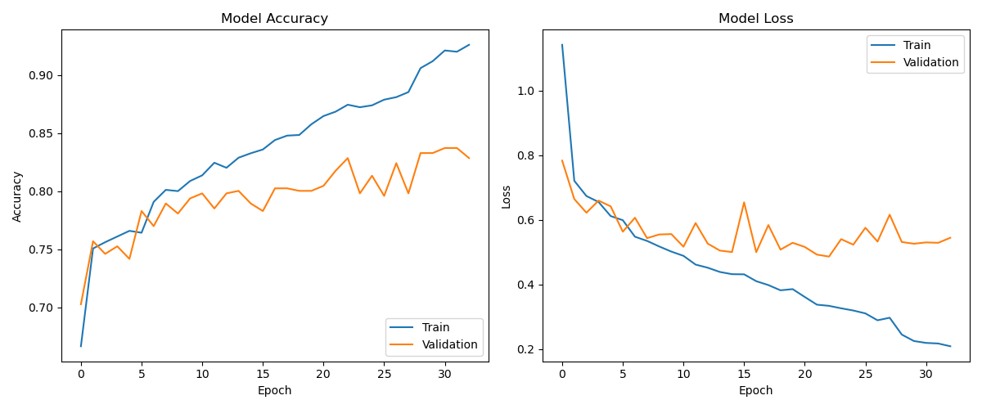
CNN_GRU

Slide 38
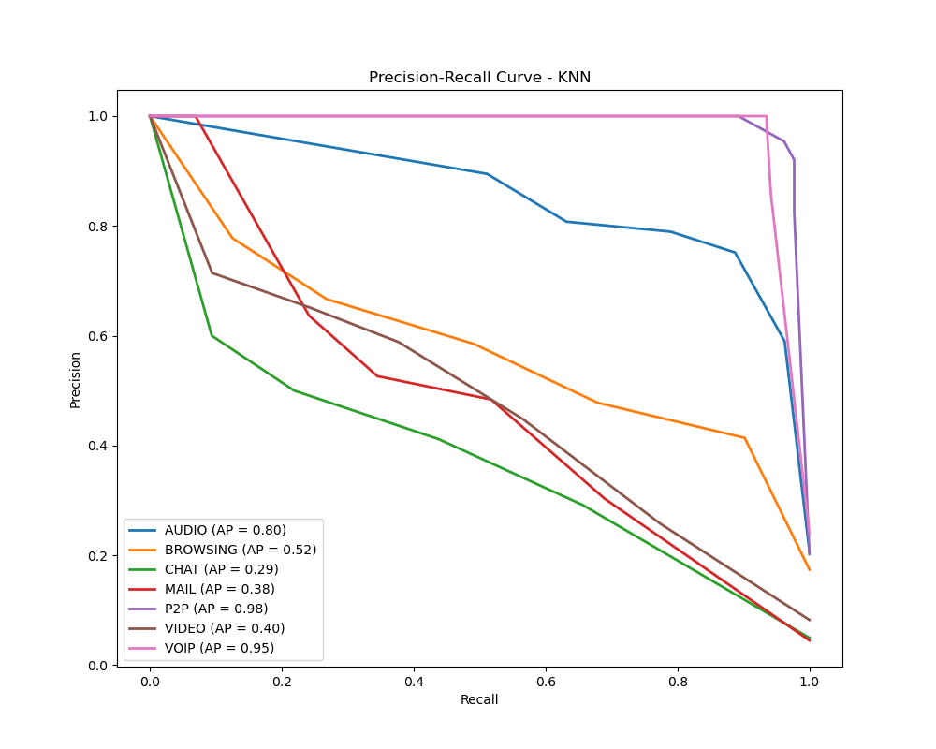
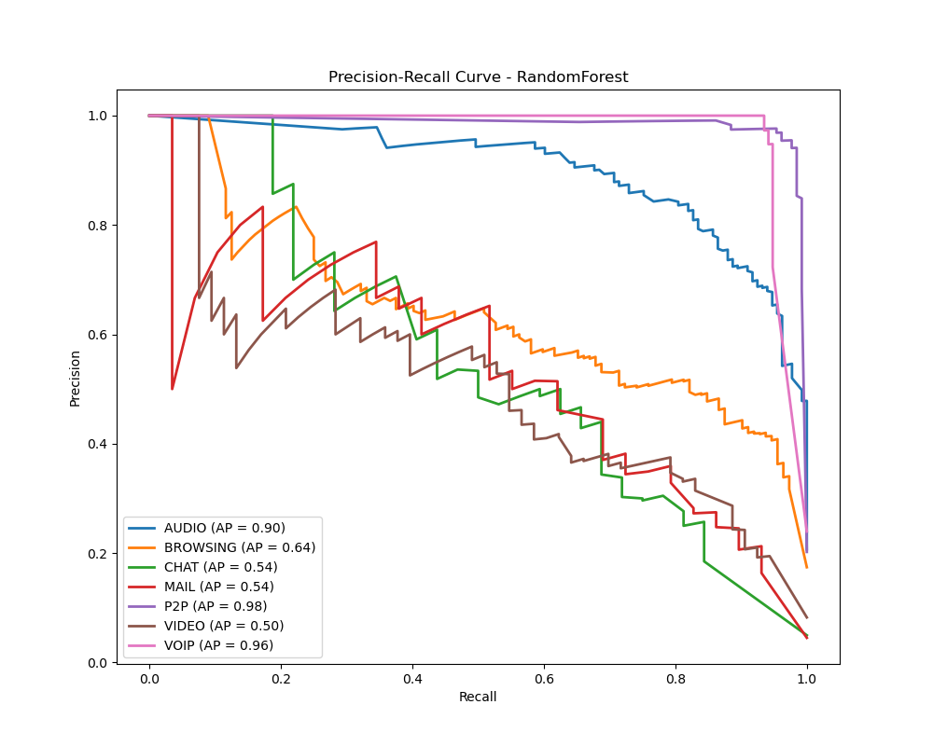
Precision Recall
KNN
RF

Slide 39
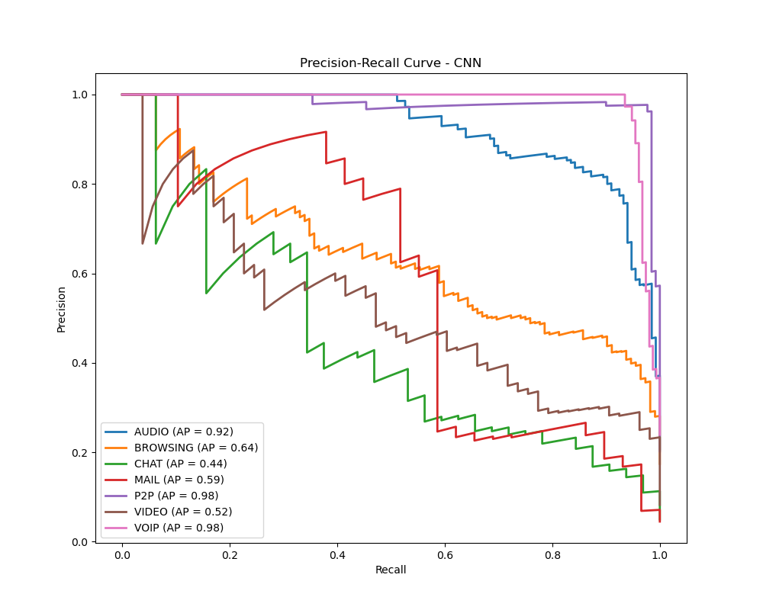
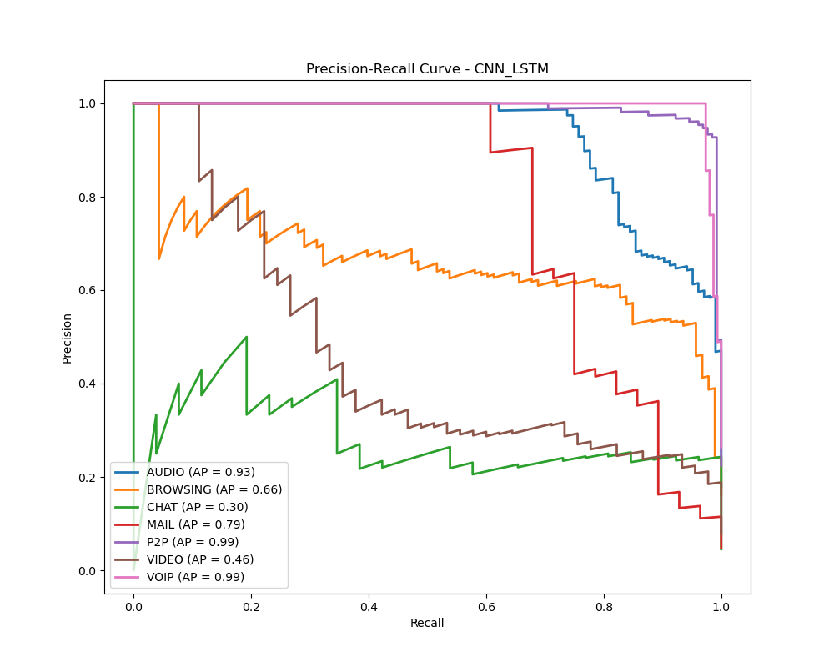
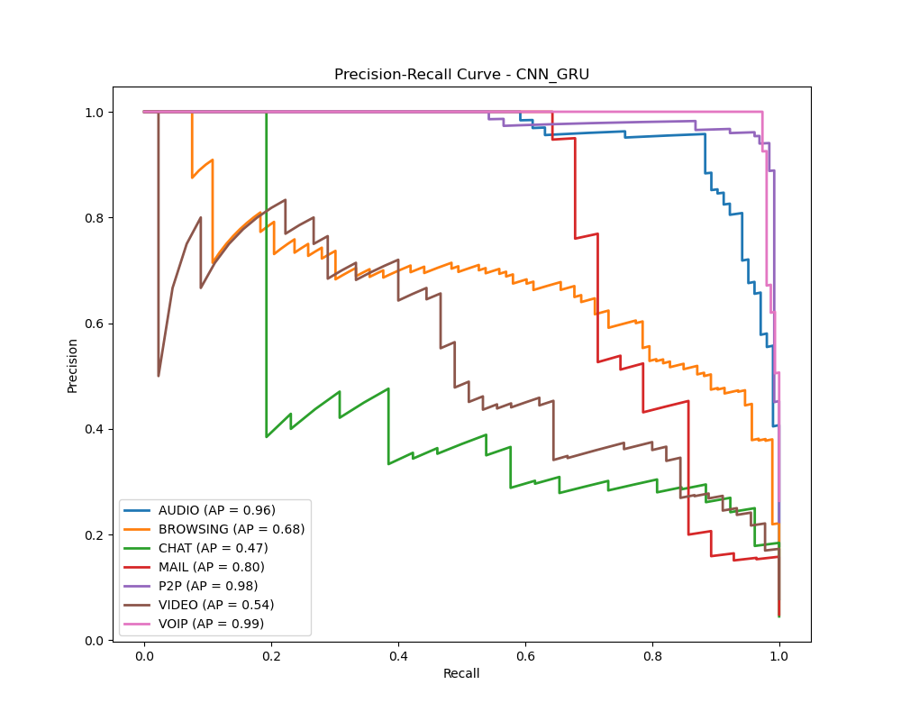
Precision Recall
CNN
CNN_LSTM
CNN_GRU

Slide 40
Summary and Future Work

Slide 41
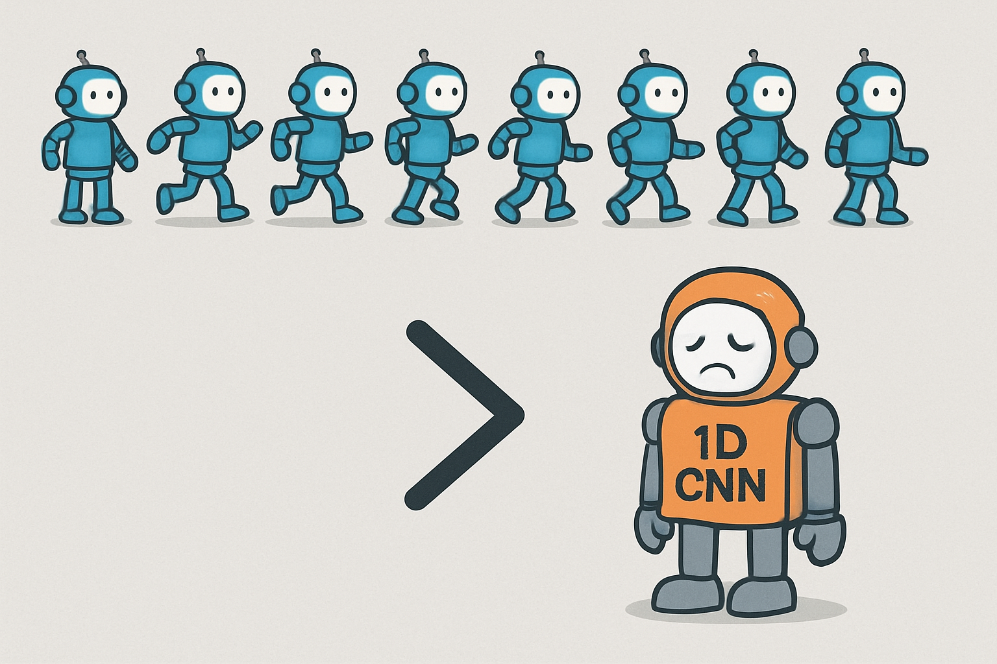
Value of Temporal Features
Accuracy uplift
CNN + LSTM: +3.7% vs. static 1D-CNN
CNN + GRU: +6.8% vs. static 1D-CNN
Flows most helped：Audio、browsing
Flows less helped: Chat
Costs & limitations
more training time
Increased model complexity & memory footprint

Slide 42
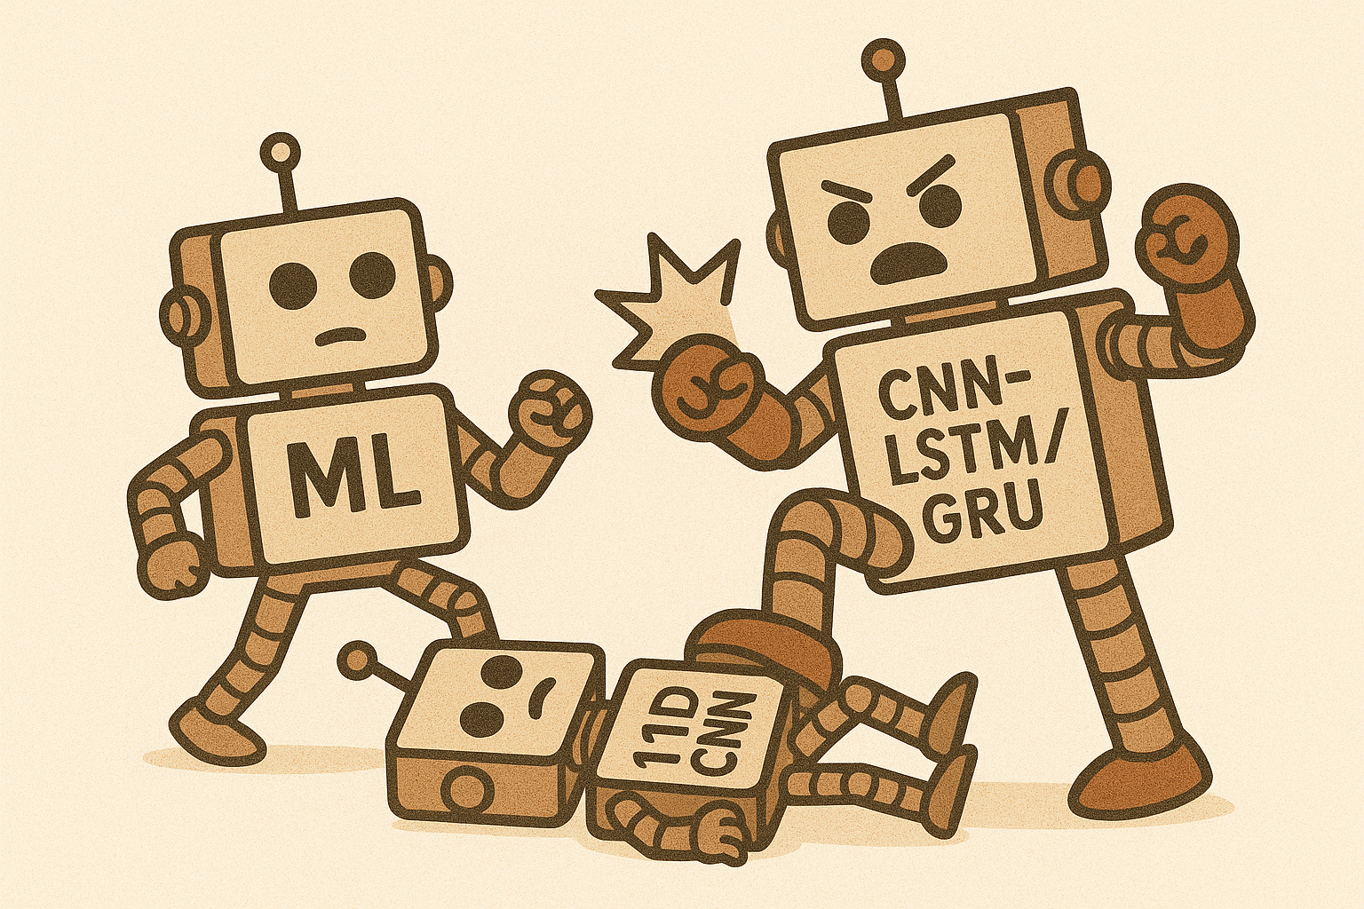
Conclusions
Key findings
Temporal models spent more resources, but it does work
Model pros & cons
K-NN: no training, slow inference
RF: robust, static
1D-CNN: high cost, complex structure, low performance
CNN-LSTM/GRU: higher cost, higher performance

Slide 43
Limitations and future directions
Limitations
Dataset size is relatively small
Fixed windowing scheme may lose fine-grained temporal variations
Future Directions
Develop adaptive windowing strategies to better capture dynamic timing patterns
Extend to multi-class application classification (e.g., YouTube, Facebook, Skype)

Slide 44
Thank you
Liu, Yucheng

